Slide 1

PulseX - The Future of Heart Care and Health
Presented By:
Mr. Yassine Bazgour
Supervised By:
Dr. Mohammed Ameksa, Dr. Mohamed-Amine Chadi

Slide 2
Problematic
01

Slide 3
7,095,536
Number of Covid19 deaths worldwide ( 2019 - 2024 )
Source:
https://data.who.int/dashboards/covid19/deaths

Slide 4
20 500 000
Deaths Due Cardiovascular Diseases (CVD)
( 2021 )
Source:
https://world-heart-federation.org/news/deaths-from-cardiovascular-disease-surged-60-globally-over-the-last-30-years-report/#:~:text=GENEVA%2C%2020%20May%202023%20%E2%80%93%20Deaths%20from,occurring%20in%20low%2D%20and%20middle%2Dincome%20countries%20(LMICs).

Slide 5
640 000 000
people living with heart and circulatory diseases across the world
Source:
https://www.bhf.org.uk/-/media/files/for-professionals/research/heart-statistics/bhf-cvd-statistics-global-factsheet.pdf

Slide 6
38%
Of all deaths in Morocco due cardiovascular Disease
Source:
https://www.researchgate.net/publication/355082014_Epidemiology_of_Cardiovascular_Diseases_in_Morocco_A_Systematic_Review

Slide 7
Solution
02

Slide 8

Telemedicine System

Slide 9


What others have done so far ?
Stethoscopes Not Capable to Record or Process Sounds
Ai Models Without Hardware & Access from Users

Slide 10


What Must be Done!
Digitalization Of Heartbeat Analysis
Embed Ai into Hardware & User-Friendly System

Slide 11
System Architecture
03

Slide 12






Prediction &
Confidence
Age
Gender
Region
Smoking State
Interface
If Normal
Encode
Data
User
Binary
Classifier
Result
Heartbeat
Audio
If Abnormal
Embedded
System
Multi
Classifier
Disease Type &
Confidence

Slide 13
Data
04

Slide 14

Source:
https://github.com/sani002/BMD-HS-Dataset

Slide 15
🔊 872 audios 🩺 6 diagnostic categories | 1 Normal | 5 Abnormal 🧑 Patient Metadata: age | gender | region | if they smoke or not ✅ Good-quality audios ⚖️ Class imbalance with Multi-Disease as majority class 📊 Widely used for heartbeats anomaly classification models

Slide 16
Diseases Types Description
AS: Aortic Stenosis
AR: Aortic Regurgitation
MS: Mitral Stenosis
MR: Mitral Regurgitation
MD: multi-disease patients
N: normal patients

Slide 17
Model
05

Slide 18
ResNet-18
2021
https://onlinelibrary.wiley.com/doi/10.1155/2021/6649970
Accuracy: 96.5%
2022
https://journals.sagepub.com/doi/abs/10.3233/MGS-220317
Accuracy: 98.95%
2024
https://ieeexplore.ieee.org/abstract/document/10779717
Accuracy: 98.6%

Slide 19
Prototype
06

Slide 20


Slide 21
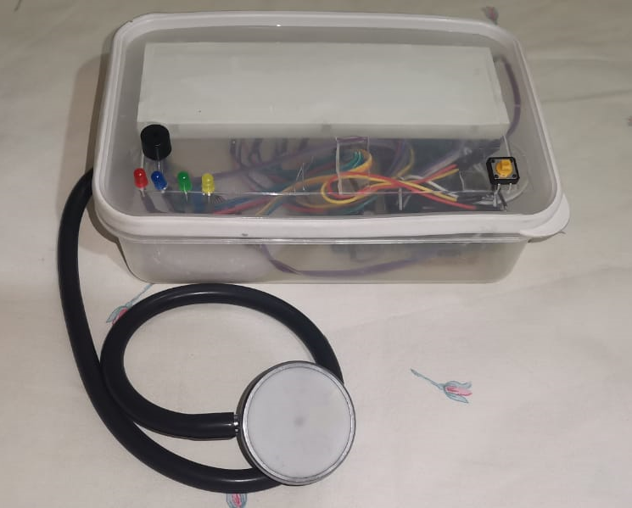

Slide 22
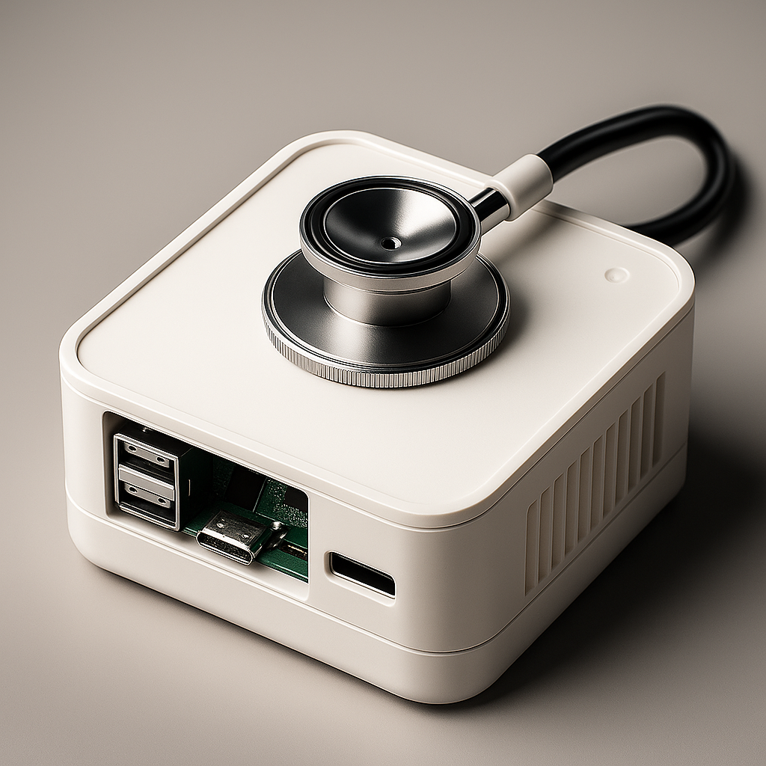

Slide 23
Interface
07

Slide 24




Technologies Used
HTML
Javascript
CSS
Python
Backend
Frontend

Slide 25
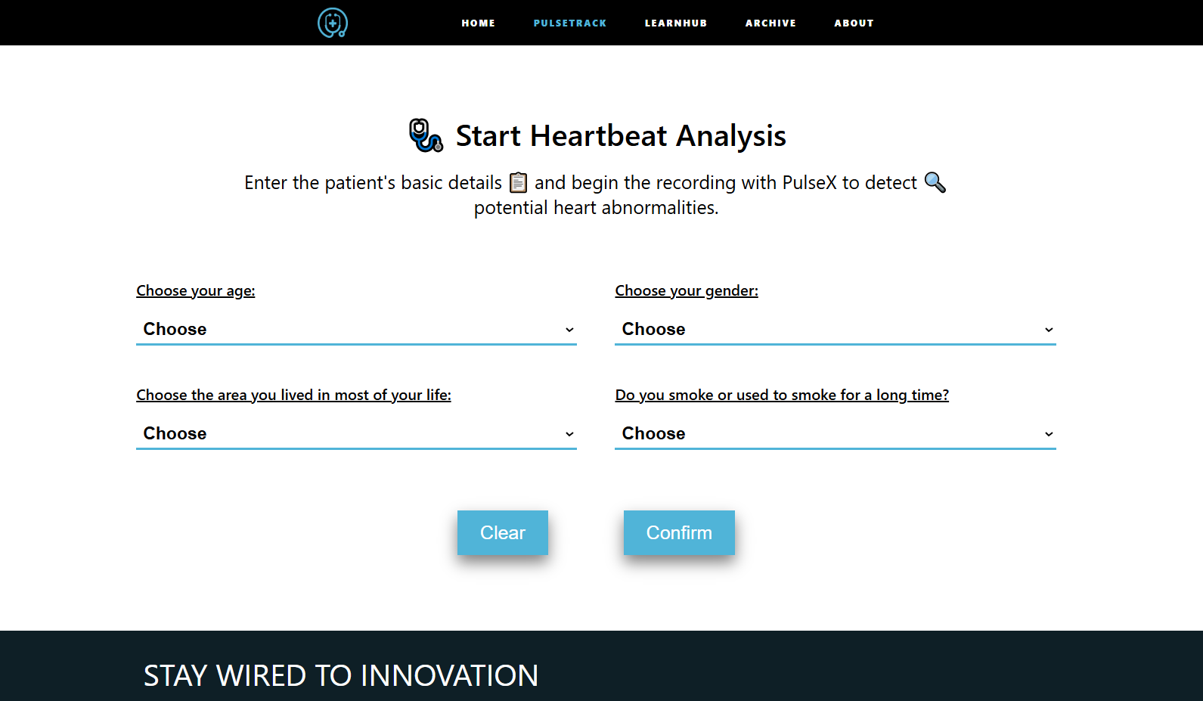

Slide 26
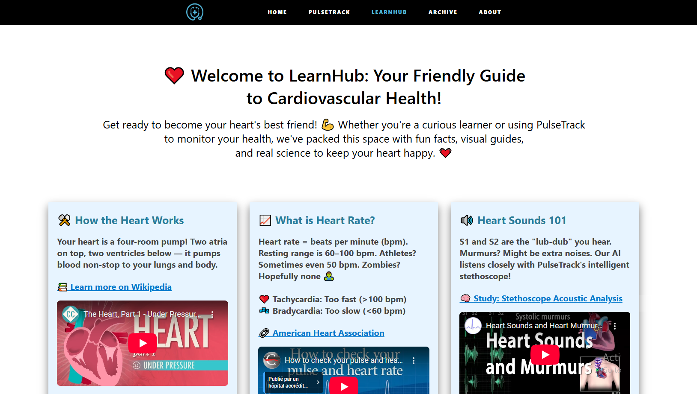

Slide 27
Results
08

Slide 28
Binary Classifier Metrics

Slide 29
Validation Accuracy: 92.65%
Precision: 89.19%
Recall: 97.06%
F1-score: 92.96%

Slide 30
Multi Classifier Metrics

Slide 31
Validation Accuracy: 80.62%
Precision: 81.13%
Recall: 80.33%
F1-score: 77.57%

Slide 32
Demo
09

Slide 33
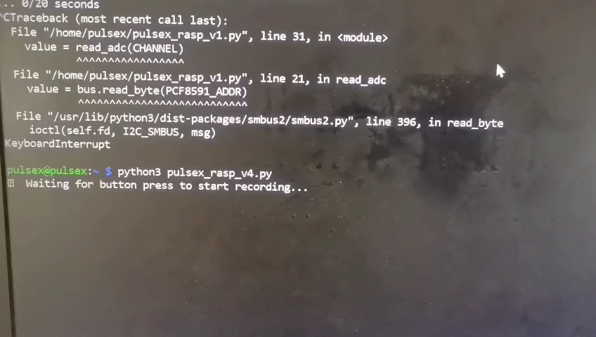

Slide 34
Discussion
10

Slide 35



Benefits
Early Detection of Cardiovascular Issues
Low-Cost, High-Quality Acoustic Analysis
Real-Time Monitoring & AI Insights

Slide 36


Limitations
Low-Quality Hardware
Low-Quality and Noisy Data

Slide 37
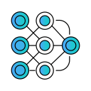


Future Work
Test Other Pretrained Models
Integrate Clinical-Grade Sensors
Enlarge Dataset and Improve its Quality

Slide 38
Price?

Slide 39
2000dh
Core components = 1547dh
Trained models + interface

Slide 40
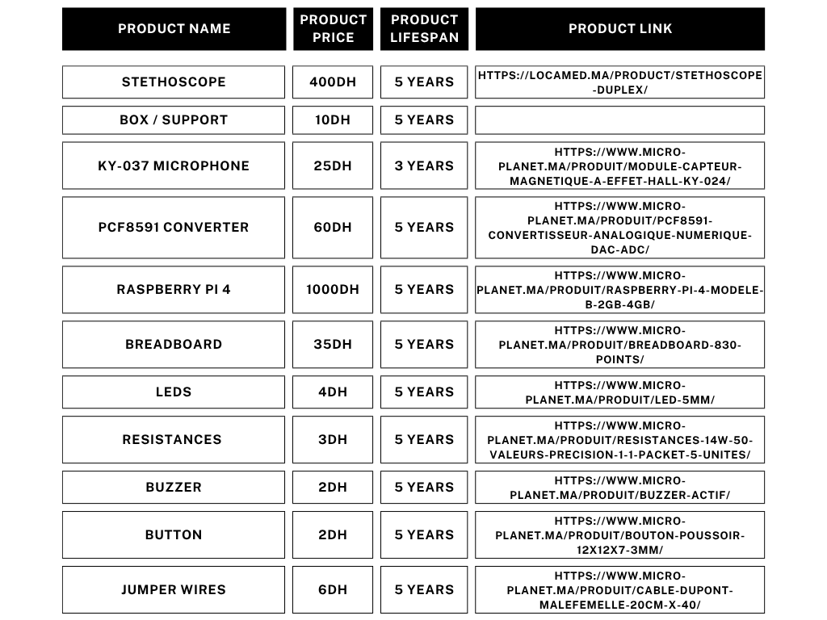

Slide 41
